Slide 1
V Model
Presented By
Anamika
Prithvi R
Rukhiya Khanum
Sanjana

Slide 2
Introduction
The V-model is an SDLC model where execution of processes happens in a sequential manner in a V-shape. It is also known as Verification and Validation model.
The V-Model is an extension of the waterfall model and is based on the association of a testing phase for each corresponding development stage. This means that for every single phase in the development cycle, there is a directly associated testing phase.
This is a highly-disciplined model and the next phase starts only after completion of the previous phase.
Testing of device is planned in parallel with corresponding stage of development.
So this model consist verification phase on one side and validation phase on otherside.

Slide 3
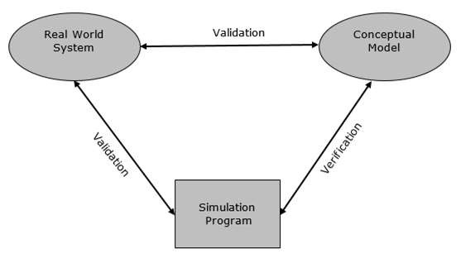

Slide 4
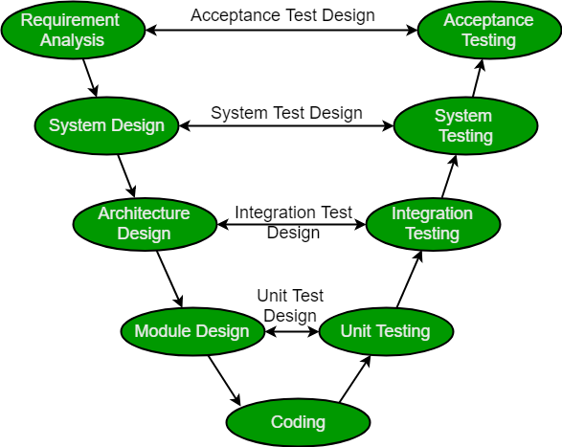
Flow of the model

Slide 5
Design Phase:
Requirement Analysis: This phase contains detailed communication with the customer to understand their requirements and expectations. This stage is known as Requirement Gathering.
System Design: This phase contains the system design and the complete hardware and communication setup for developing product.
Architectural Design: System design is broken down further into modules taking up different functionalities. The data transfer and communication between the internal modules and with the outside world (other systems) is clearly understood.
Module Design: In this phase the system breaks dowm into small modules. The detailed design of modules is specified, also known as Low-Level Design (LLD).

Slide 6
Testing Phases:
Unit Testing: Unit Test Plans are developed during module design phase. These Unit Test Plans are executed to eliminate bugs at code or unit level.
Integration testing: After completion of unit testing Integration testing is performed. In integration testing, the modules are integrated and the system is tested. Integration testing is performed on the Architecture design phase. This test verifies the communication of modules among themselves.
System Testing: System testing test the complete application with its functionality, inter dependency, and communication.It tests the functional and non-functional requirements of the developed application.
User Acceptance Testing (UAT): UAT is performed in a user environment that resembles the production environment. UAT verifies that the delivered system meets user’s requirement and system is ready for use in real world.

Slide 7
Advantages
This is a highly disciplined model and Phases are completed one at a time.
V-Model is used for small projects where project requirements are clear.
Simple and easy to understand and use.
This model focuses on verification and validation activities early in the life cycle thereby enhancing the probability of building an error-free and good quality product.
It enables project management to track progress accurately.

Slide 8
Disadvantages
High risk and uncertainty.
It is not a good for complex and object-oriented projects.
It is not suitable for projects where requirements are not clear and contains high risk of changing.
This model does not support iteration of phases.
It does not easily handle concurrent events.

Slide 9
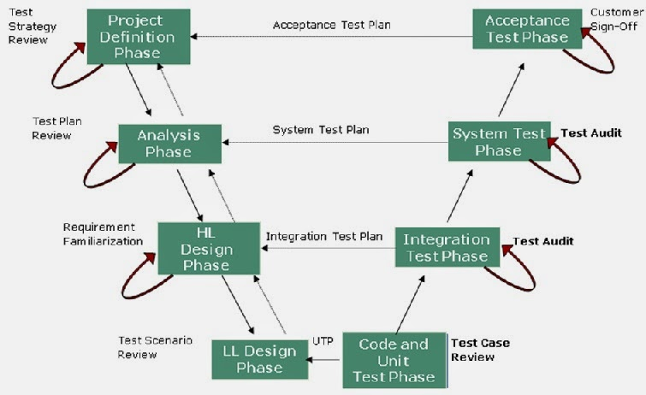

Slide 10
Project that can be applied with V model
Example Could be Flipkart, We Get a particular set of Requirements by them to build a search box let’s say,
Verification process makes sure that that particular feature is built according to requirements
Validation process is basically testing that feature if its working in all the way the client wants
Validation has different testing process that can be done to be sure if it works the right way starting from integration testing till UAT.

Slide 11
Thank You

